Slide 1

Delhi
Air Quality Prediction
Data-Driven Insights
Prepared by Lipsita Tripathy
January 2024

Slide 2

About Me
Lipsita
Tripathy
Former QA Analyst Transitioning to Data Scientist
With a background in
🎓Electronics and Instrumentation Engineering
📊 Passionate about translating data
into actionable insights
🌐 Striving to contribute to a cleaner, healthier future

Slide 3

Problem Statement ?
By predicting next-day air quality, how can we empower decision-makers with actionable insights to implement timely measures and safeguard urban environments effectively?
Proposed Solution
Implementing a data-driven model to accurately predict next-day air quality index empowering informed decision-making for a healthier environment.

Slide 4
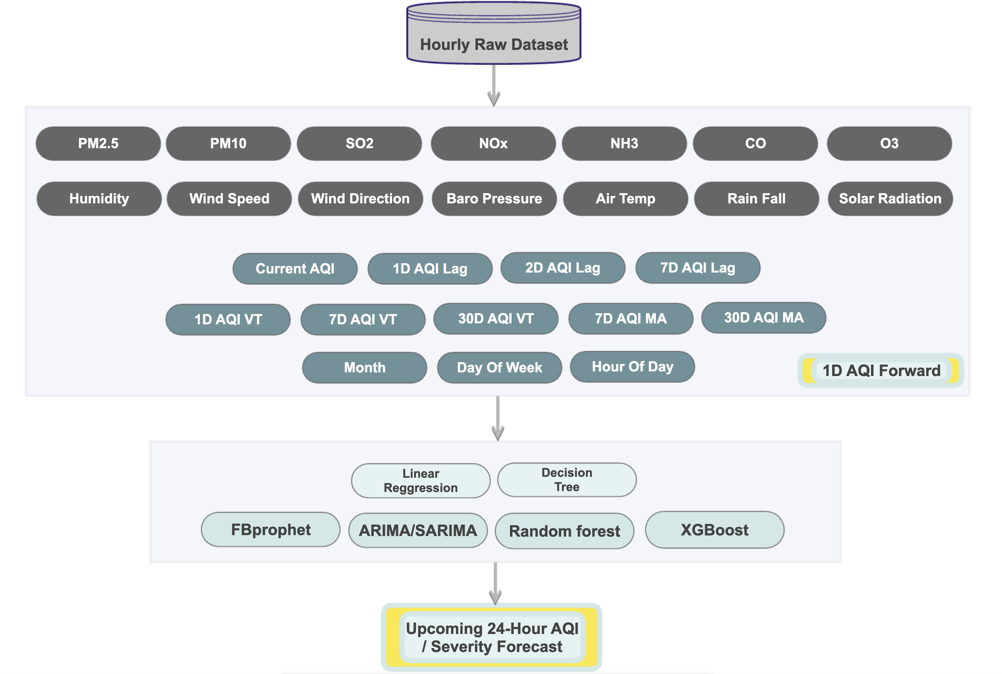
Data
(Kaggle link)

Slide 5
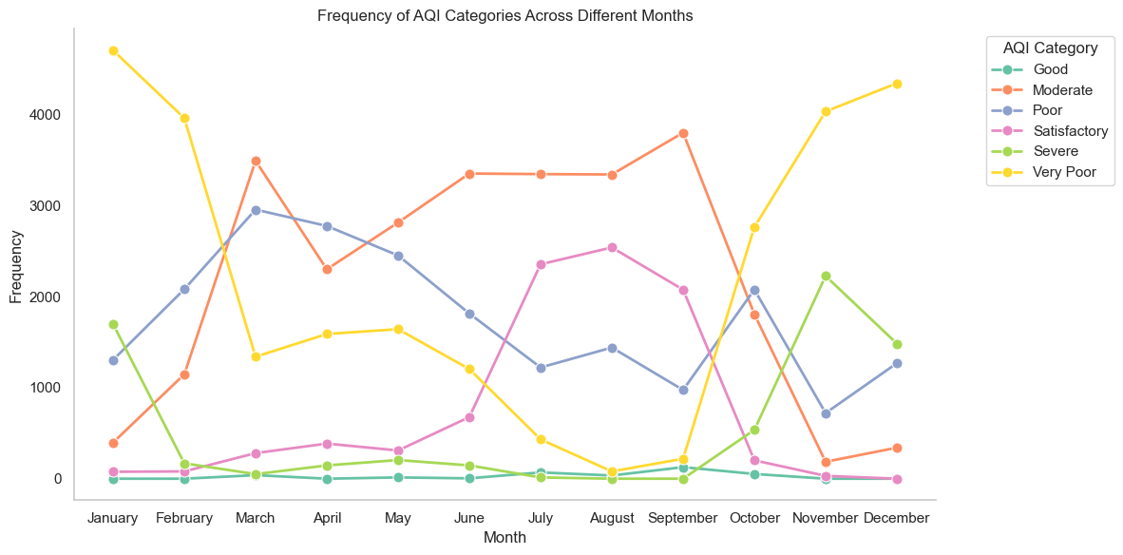
Unveiling Air Quality Trends

Slide 6
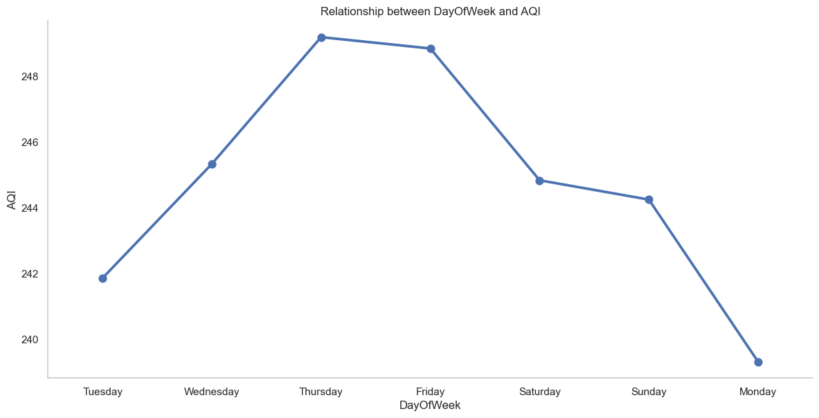
Weekly Rhythms

Slide 7
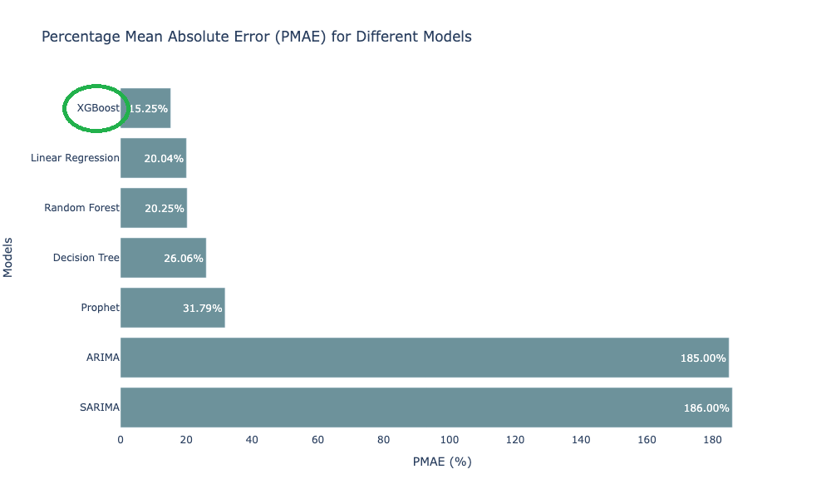
Model Comparision on PMAE

Slide 8
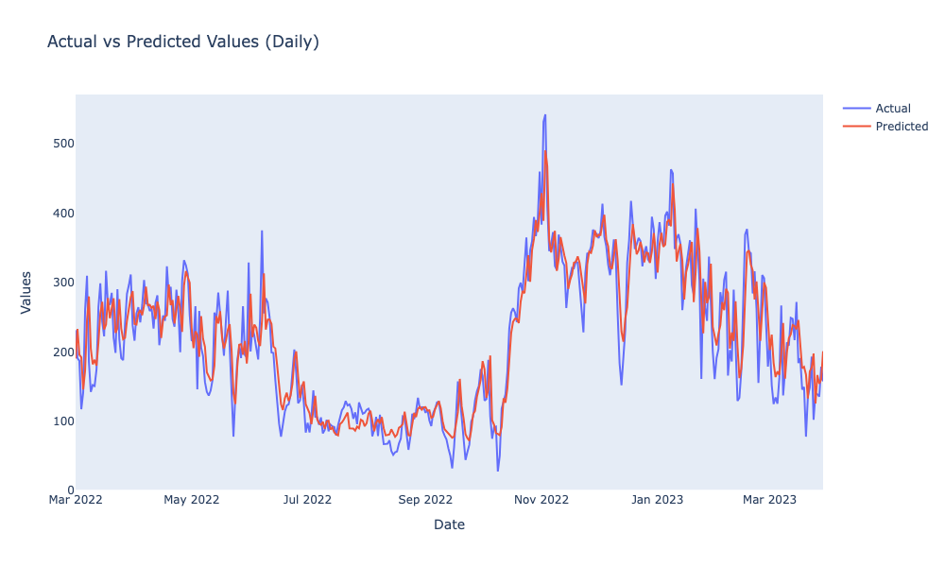
Actual Vs. Predicted AQI

Slide 9
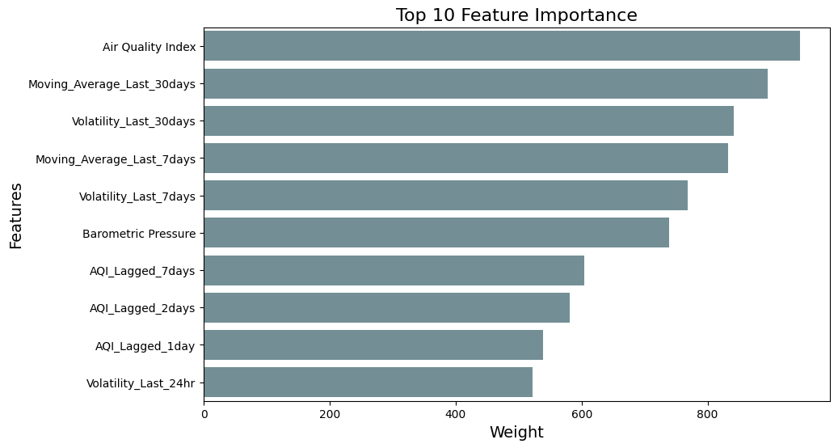
Feature Importance

Slide 10
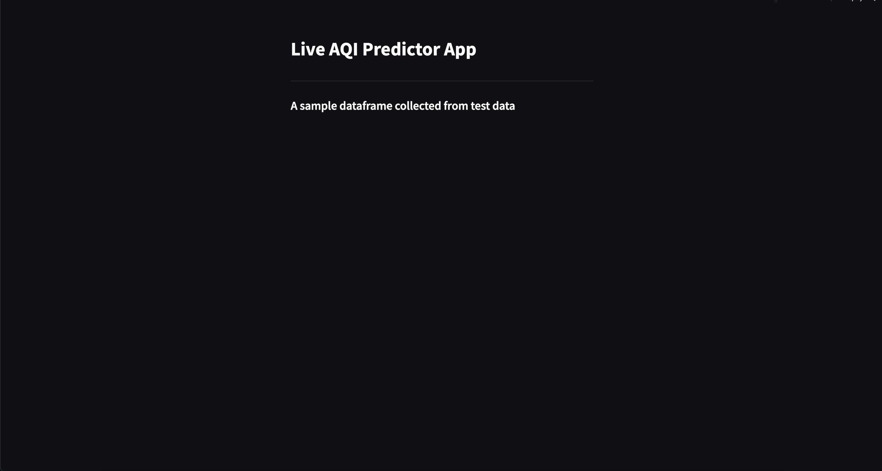

Slide 11

Forging Ahead
Treat Individual Station's Data Independently
Build Location Dependencies
Predict AQI Differences
Extend Prediction Horizon
Explore Advanced Models

Slide 12





🙏 Thank You... Let's Connect!
linkedin.com/in/lipsitatripathy
github.com/lipsitalt/AirQualityPredictor
lipsitalt@gmail.com

